Slide 1


Anand Kramer
1/7/24

Slide 2

Outline
Executive Summary
Introduction
Methodology
Results
Conclusion
Appendix

Slide 3
Executive Summary
The commercial space age is here, for that reason our company Space Y was born. Space Y wants to make space travel affordable for all.

Slide 4
Introduction
Space Y is here to compete in the commercial space race. We are making rocket launchers relatively inexpensive for everyone.
Space Y can save millions in every launch of our Eagle rocket because we can reuse it’s first stage.
In addition, we can determine if the first stage of our competitor will land and determine the cost of a launch by using data science and machine learning models.

Slide 5

Section 1

Slide 6
Methodology
Executive Summary
Data collection methodology:
Data was gathered from SpaceX REST API and web scraping from wiki pages.
Perform data wrangling
Data collected in JSON form object and HTML tables which were converted into a Pandas dataframe for visualization and analysis.
Perform exploratory data analysis (EDA) using visualization and SQL
Perform interactive visual analytics using Folium and Plotly Dash
Perform predictive analysis using classification models
Use machine learning to determine if the first stage of Falcon 9 will land successfully.

Slide 7
Data Collection
The data was gathered from the SpaceX REST API and web scraped from wiki pages
SpaceX REST API endpoint
Get request using the requests library
Get past launch data as JSON objects
Convert JSON to a data frame
Web Scraping Falcon 9 launch records
Use Beautiful Soup to web scrape HTML tables
Parse Data from tables
Convert tables into a data frame
https://github.com/pinnaclewealth/capstone-space-Y.git

Slide 8
Data Collection – SpaceX API
Collect and make sure the data is in the correct format from an API
SpaceX REST API endpoint
Get request using the requests library
Get past launch data as JSON objects
Convert JSON to a data frame
Extract information about booster name, launch site, payload mass and landing site
Filter the data frame to only include Falcon 9 launches
Deal with Missing Values
Data Wrangling
https://github.com/pinnaclewealth/capstone-space-Y.git

Slide 9
Data Collection - Scraping
Perform web scraping to collect Falcon 9 historical launch records from Wikipedia page.
Request the Falcon 9 Launch Wiki page from its URL
Beautiful Soup object from the response
Extract all columns/variable names from the HTML table header
Create a data frame by parsing the launch HTML tables
Data Wrangling
https://github.com/pinnaclewealth/capstone-space-Y.git

Slide 10
Data Wrangling
Perform data wrangling to obtain data from web scraping and API connections.
Identify the missing values
Identify which columns are numerical and categorical
Calculate the number of launches on each site
Calculate the number and occurrence of each orbit
Calculate the number and occurrence of mission outcome per orbit type
Create a landing outcome label from Outcome column
https://github.com/pinnaclewealth/capstone-space-Y.git

Slide 11
EDA with Data Visualization
Perform Exploratory Data Analysis (EDA) to find patterns in the data and determine what would be the label for supervised models.
Summary Of charts that were plotted:
Catplot to visualize the relationship between Flight Number and Payload
Catplot to visualize the relationship between Flight Number and Launch
Catplot to visualize the relationship between Payload and Launch Site
Barchart to visualize the relationship between success rate and Orbit type
Catplot to visualize the relationship between Flight Number and Orbit type
Catplot to visualize th
Line chart to visualize the launch success yearly trend

Slide 12
EDA with SQL
SQL queries performed:
Display the names of the unique launch sites in the space mission:
SELECT DISTINCT(launch_site) FROM SPACEXTBL:
Display 5 records where launch sites begin with the string ‘CCA’:
SELECT * FROM SPACEXTBL WHERE launch_site LIKE ‘CCA%’ LIMIT 5;
Display the total payload mass carried by boosters launched by NASA (CRS):
SELECT SUM(payload_mass_kg) AS TOTAL_PAYLOAD_MASS FROM SPACEXTBL WHERE customer = ‘NASA (CRS)’;
Display average payload mass carried by booster version F9 v1.1:
SELECT AVG(payload_mass_kg) AS AVG_PAYLOAD_MASS FROM SPACEXTBL WHERE booster_version = ‘F9 v1.1’;
List the data when the first successful landing outcome in ground pad was achieved:
SELECT MIN(DATA) AS first_successful_landing FROM SPACEXTBL WHERE (landing_outcome) = ‘Success(ground pad)’;

Slide 13
Build an Interactive Map with Folium
Summary of map objects that were created and added to the Folium map
folium.Circle and folium.Marker to add a highlighted circle area with a text label on a specific coordinate for each launch site on the site map.
MarkerCluster object to simplify a map containing many markers having the same coordinate
MousePosition on the map to get coordinate for a mouse over a point on the map.
Folium.PolyLine to draw a line between a launch site to its closest city, railway and highway

Slide 14
Build a Dashboard with Plotly Dash
This dashboard application contains input components sucha s a dropdown list and range slider to interact to perform interactive visual analytics on SpaceX launch data in real-time.
A launch Site Drop-down Input Component with 4 different launch sites and a dropdown menu to select different launch sites.
Callback function to render success-pie-chart based on the selected dropdown.
Range slider to select payload for visual patterns

Slide 15
Predictive Analysis (Classification)
Predictive Analysis allows for building, evaluating, improving, and identifying the best performing classification model.
Creation of a NumPy array from the column Class in data.
Data standardization
Use of function train_test_split to split the data X and Y into training and test data
Search for hyperparameters for logistic regression, SVM, Decision Tree, and KNN classifiers
Searching for the method that performs best using data

Slide 16
Results
Exploratory data analysis results
Interactive analytics demo in screenshots
Predictive analysis results

Slide 17

Section 2

Slide 18
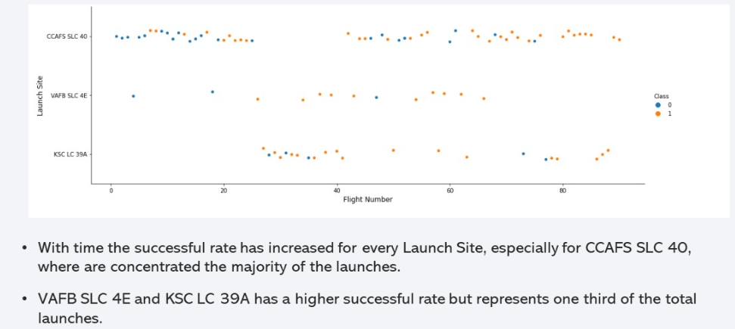
Flight Number vs. Launch Site

Slide 19
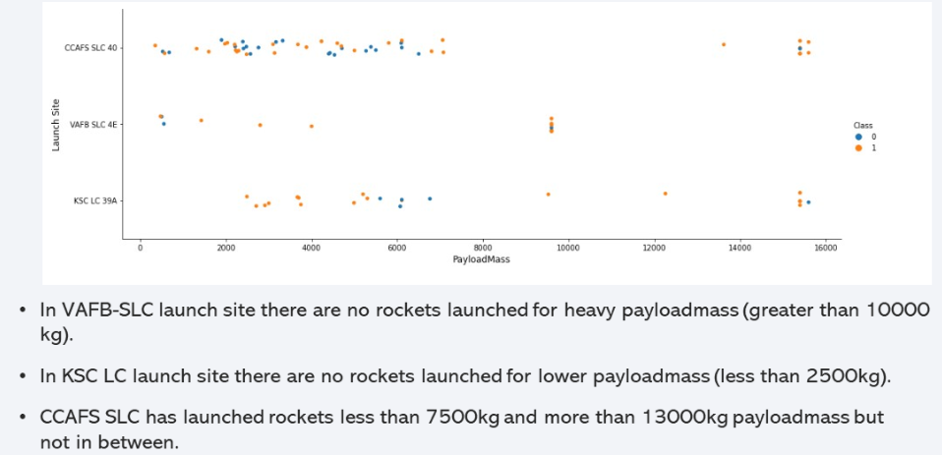
Payload vs. Launch Site

Slide 20
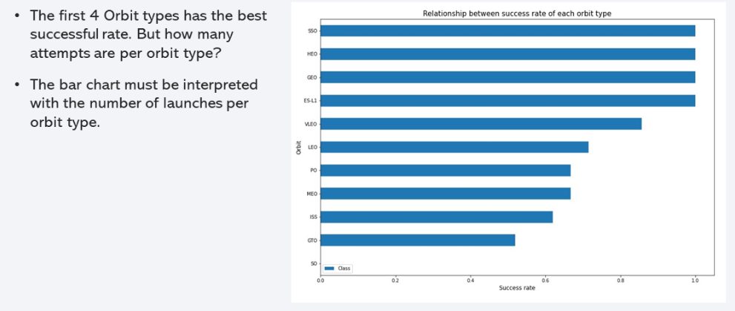
Success Rate vs. Orbit Type

Slide 21
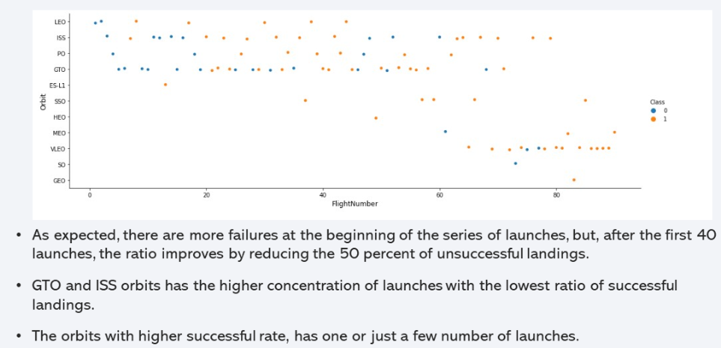
Flight Number vs. Orbit Type

Slide 22
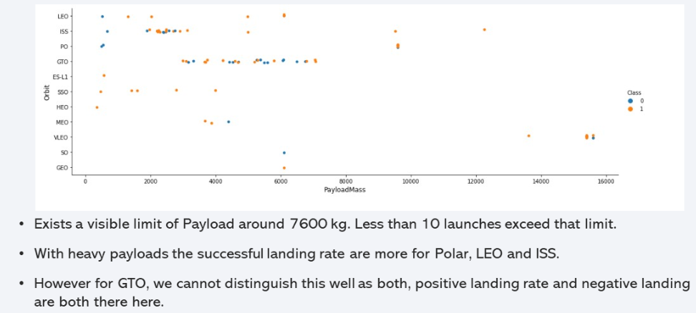
Payload vs. Orbit Type

Slide 23
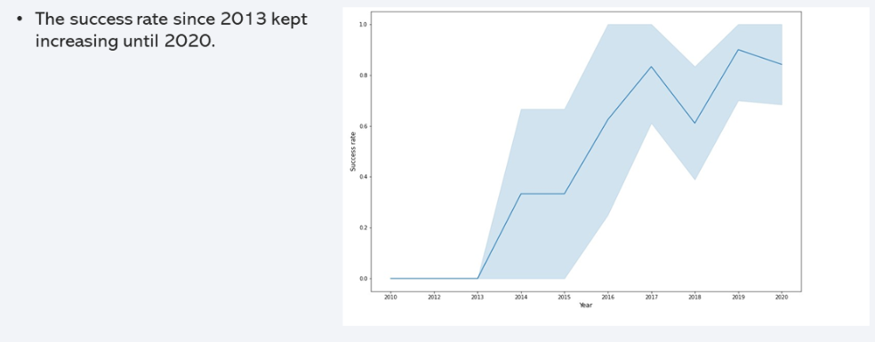
Launch Success Yearly Trend

Slide 24
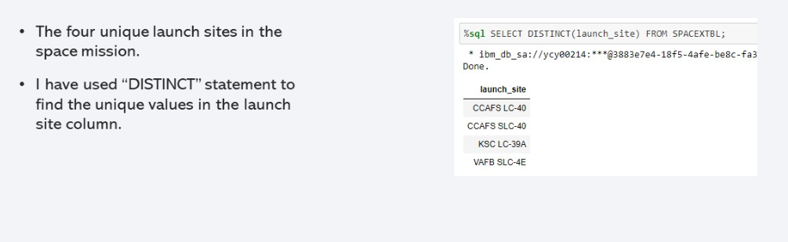
All Launch Site Names

Slide 25
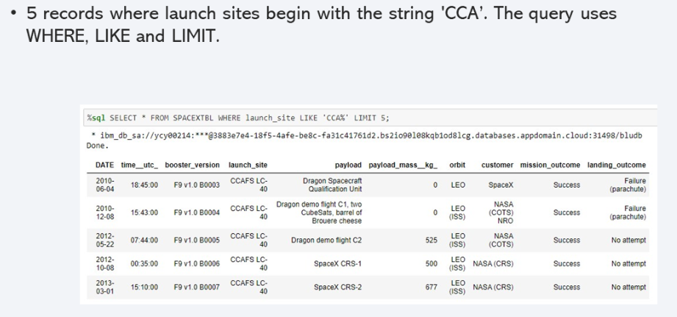
Launch Site Names Begin with 'CCA'

Slide 26
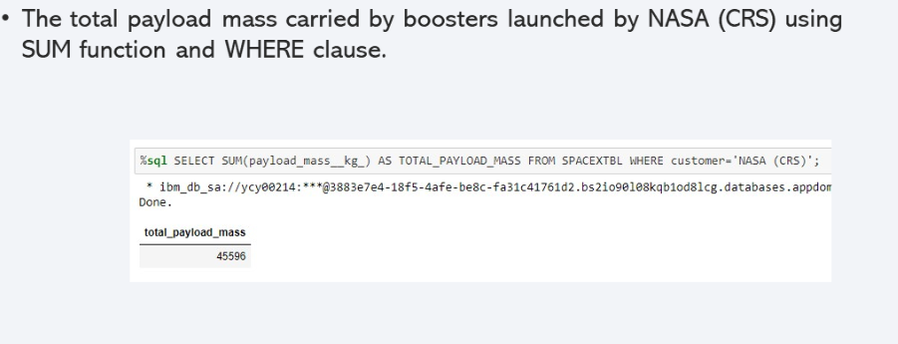
Total Payload Mass

Slide 27
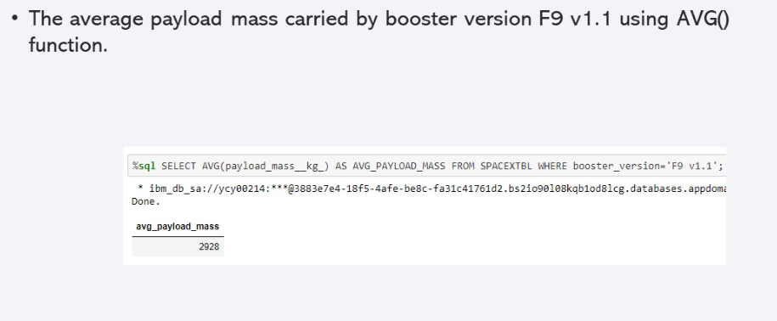
Average Payload Mass by F9 v1.1

Slide 28
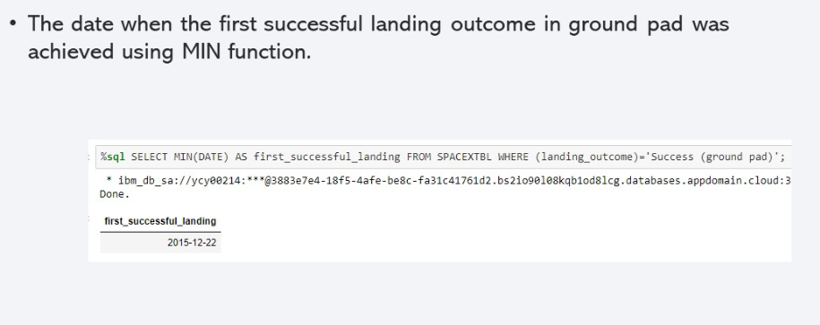
First Successful Ground Landing Date

Slide 29
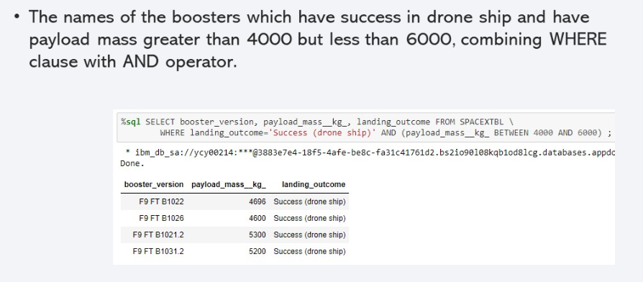
Successful Drone Ship Landing with Payload between 4000 and 6000

Slide 30
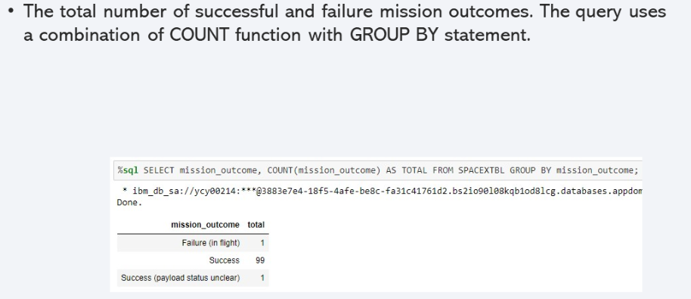
Total Number of Successful and Failure Mission Outcomes

Slide 31
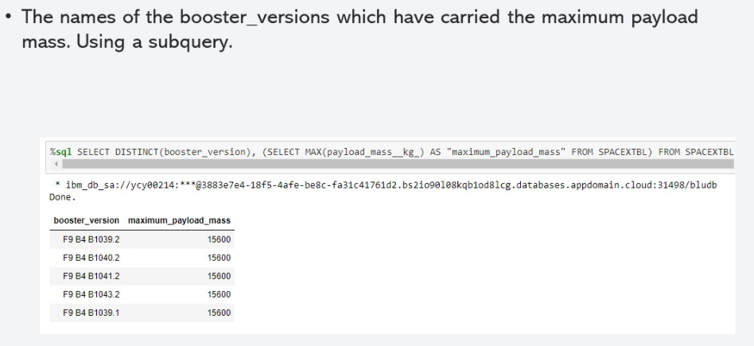
Boosters Carried Maximum Payload

Slide 32
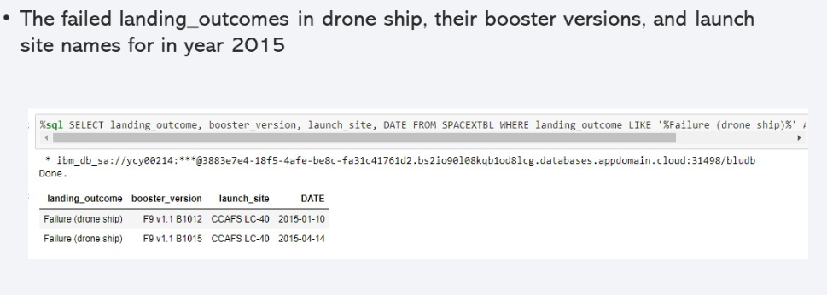
2015 Launch Records

Slide 33
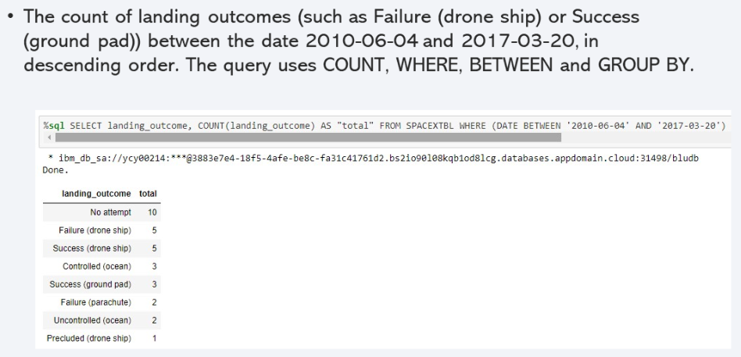
Rank Landing Outcomes Between 2010-06-04 and 2017-03-20

Slide 34

Section 3

Slide 35
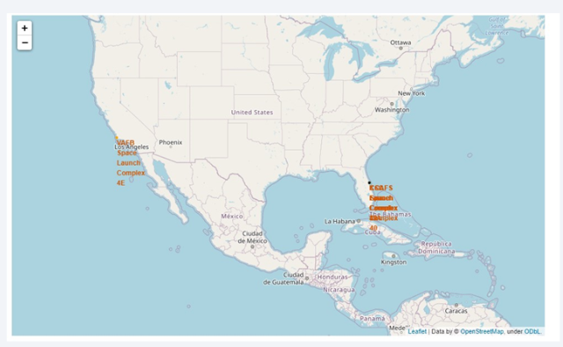
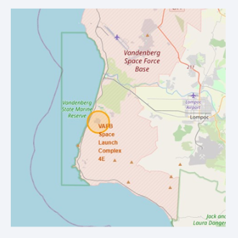
All Launch Sites
All launch sites are in very close proximity to the coast and in restricted areas.

Slide 36
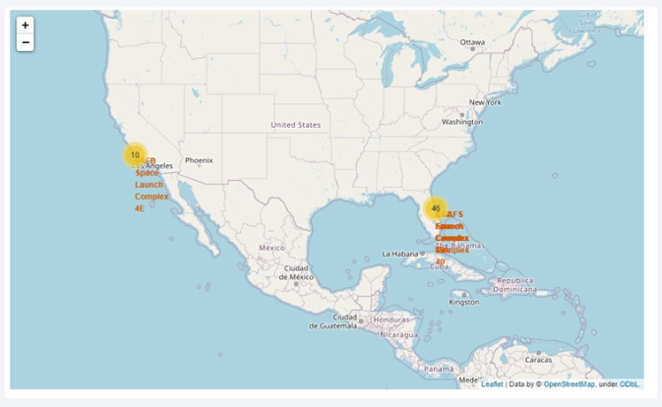
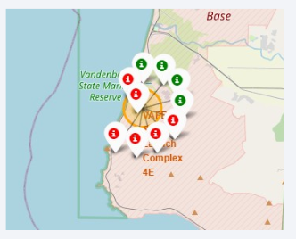
Success/Failed Launches for Each Site
First map shows clusters for each launch site while the second shows a green marker for successful launches and a red marker for failed launches.

Slide 37
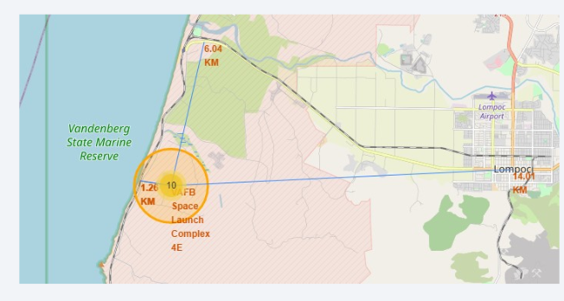
Launch Site and its Proximities
Launch sites are near railways, roads, highways and coastlines. Maintaining a safe distance to cities is crucial for success.

Slide 38

Section 4

Slide 39
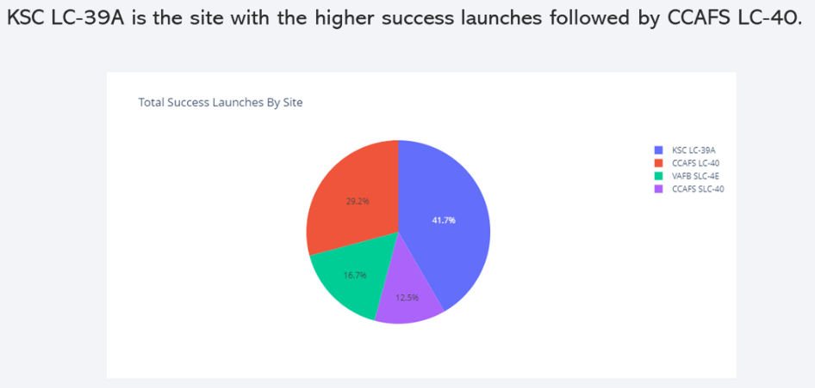
Total Success Launches by Site

Slide 40
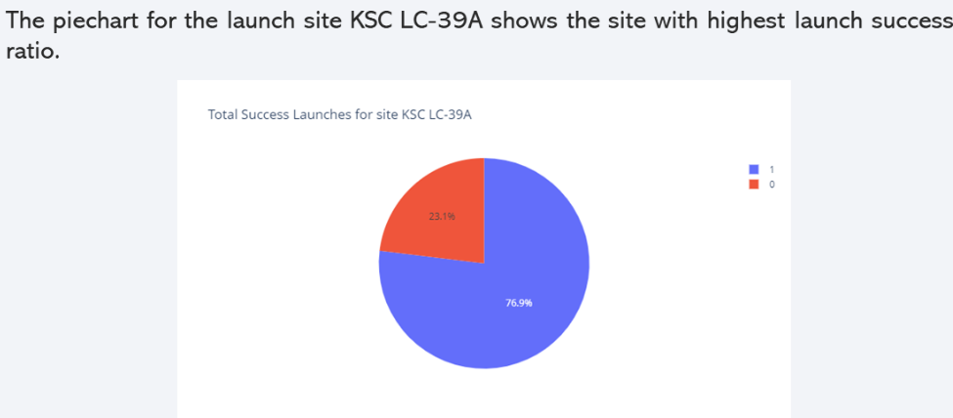
KSC LC-39A

Slide 41
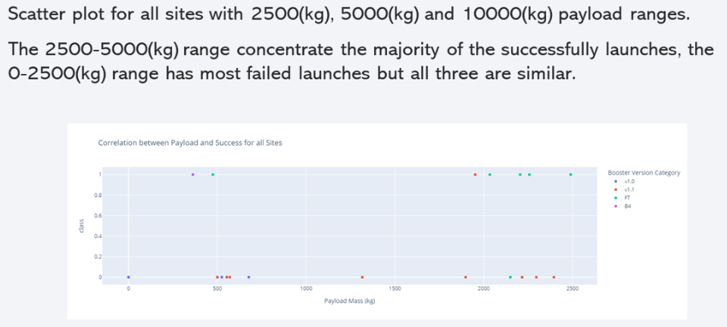
Payload vs. Launch Outcome

Slide 42
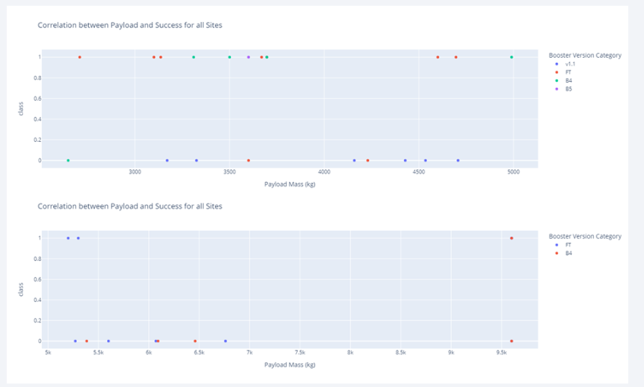
Payload vs. Launch Outcome

Slide 43

Section 5

Slide 44
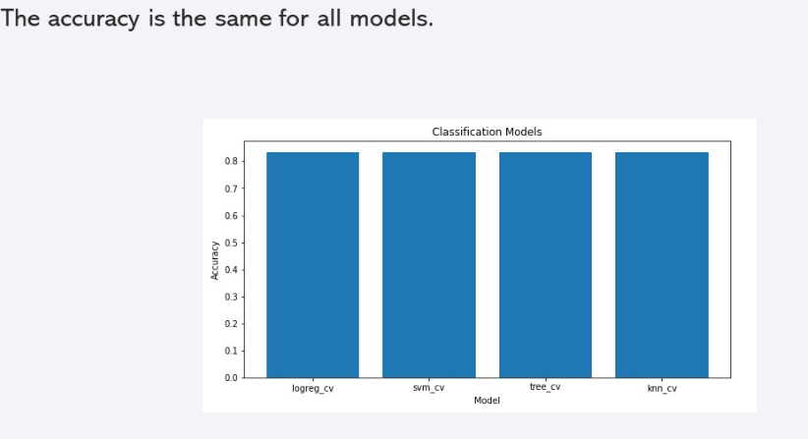
Classification Accuracy

Slide 45
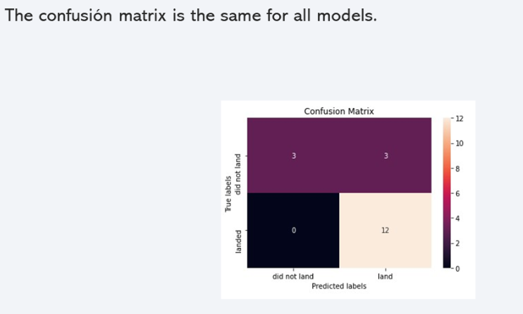
Confusion Matrix

Slide 46
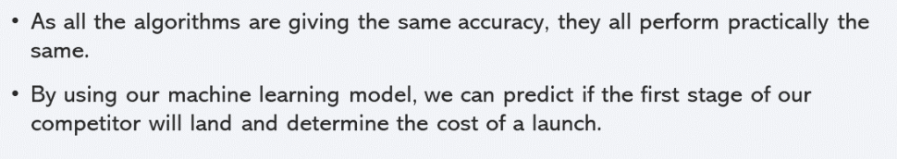
Conclusions

Slide 47
Appendix
For all related files please view GitHub link:
Data Science Capstone

Slide 48


